Slide 1

Fraser Health Surgical Bookings
Team #3
Andriy Ignatov
Anoop Jayasankar
Carmen Ng
Christopher Halket
Masoome Esmaeili
Michelle Urbina-Beggs
Priyadarshini Ramesh
Notes:
Fraser Health conducts over 100,000 surgeries per year from vascular and thoracic surgery to dental surgery.
Across 11 hospitals through out the region.

Slide 2




End-to-end journey: Scheduler
Meet Our Personas
Patient
Provider
Provider MOA
Booking clerk (FH)
Iron Man
Dr. Strange
Black Widow
Hulk
Notes:
The story you are about to see is true. The names have been changed to protect the innocent."
Iron Man suffers from high blood pressure and back pain
He connects with Dr. Strange and both agree the best course of action is for Iron Man to have surgery
Black Widow, Dr. Strange's Medical Office assistant, completes a hand written form and faxes the surgical booking package to hospital.
Booking clerk Hulk, receives the fax amongst other faxes and enters the information on the hospital EMR.

Slide 3




Current state (referral to booking clerk):
Hulk meets with Dr. Strange
Fax (BOO!)
Surgical booking package
Notes:
Problem Statement
Description:
>100,000 surgeries per year in FH from vascular and thoracic surgery to dental surgery
We are concerned with the initial stages of the booking process, which is getting the surgical booking package from the provider to the booking clerk
Surgical booking package completed by provider’s office when the patient meets with the provider and decides they are ready, willing, and able to have surgery
Package includes standard booking form, different types of information depending on medical history and type of surgery required
Currently, package faxed to FH by the MOA at the provider’s office and transcribed by booking clerks into EMR
Impact:
Transcription is time consuming
Data entry errors
Current process not timely (e.g. delays in entry, delays in review and information checks)
Potential delays in surgical booking (i.e. impacts to patient health)

Slide 4

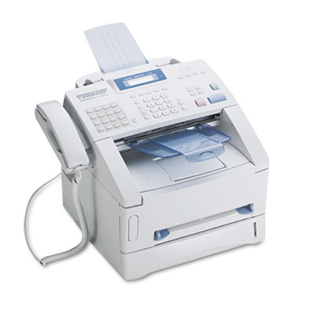
Digitize the workflow, Axe the FAX!
Efficiency!
Accuracy!
Safety!
Notes:
During the remainder of this presentation how we will digitize the workflow to axe the fax.
Efficiency: Reduce workload clerical staff, who instead can focus on the patients they are supporting. thus, enhancing patient care.
Accuracy: Eliminate errors associated with transcription.
Safety: With errors eliminated clinical providers can make better decisions based on better quality data.

Slide 5

Future state (referral to booking clerk):
Hulk meets with Dr. Strange
Option 1: E-fax to Power Automate and Power App
Option 2: Webform to Power App
Notes:
Product Description:
2 options:
1) Webform with API to Power App
2) Fax to folder with Power Automate flow that uses AI to integrate information to Power App
Data stored in Power App
App will have a user interface to allow for data validation by booking clerks
Creativity & Innovation:
Eliminate need for data entry
User-friendly interface and flexibility of options for users
Patient-centered design (e.g. data integrity, decreasing time to booking)

Slide 6
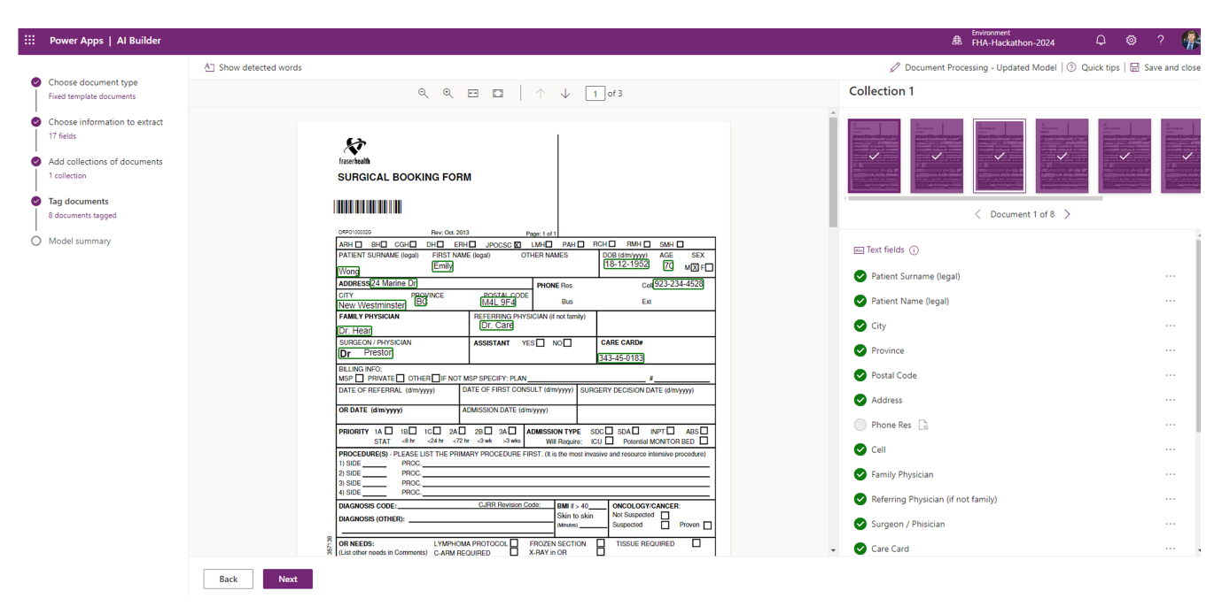
Demo

Slide 7
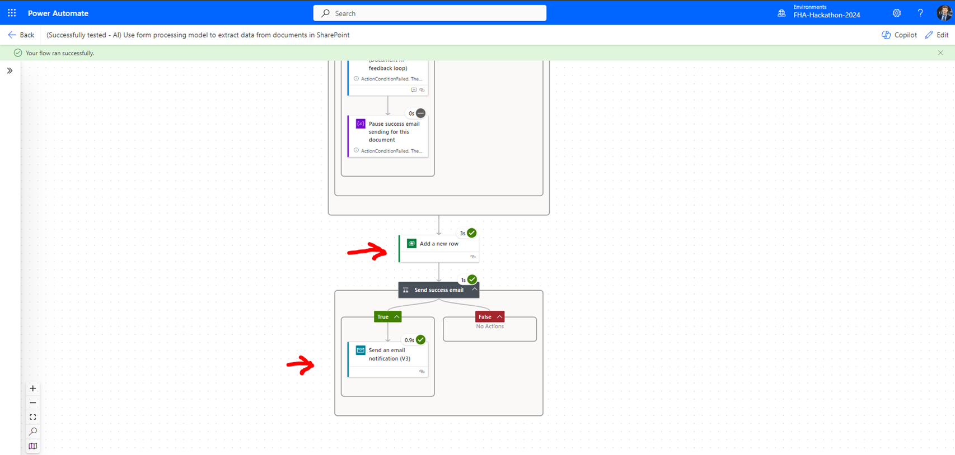

Slide 8
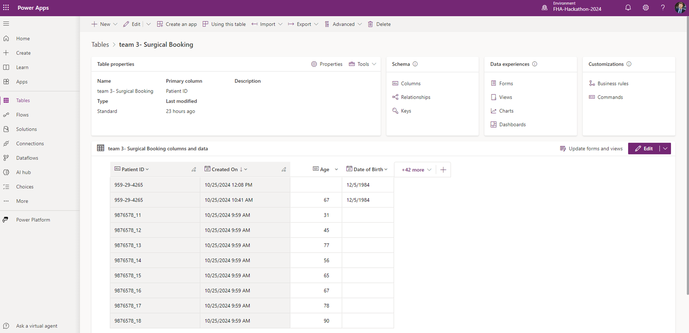

Slide 9
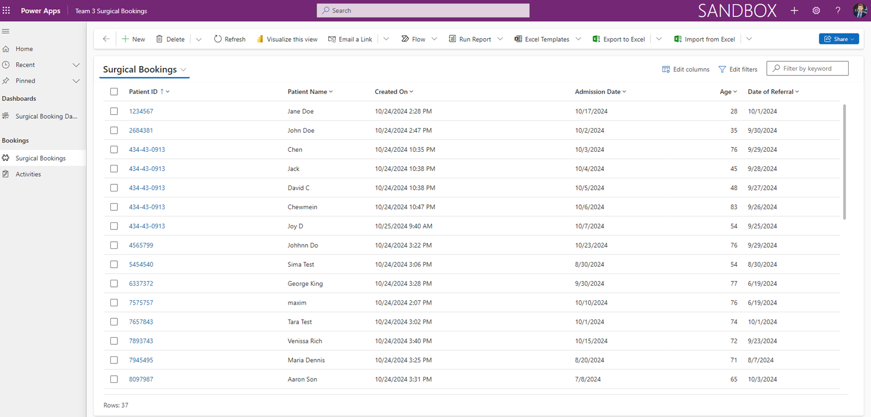

Slide 10
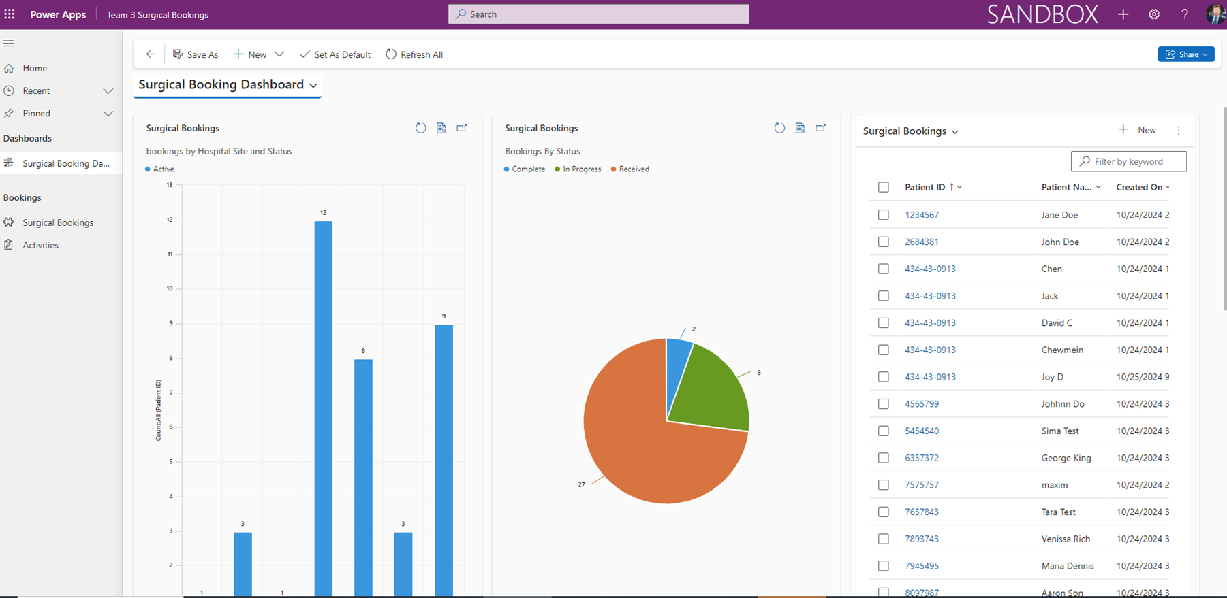

Slide 11
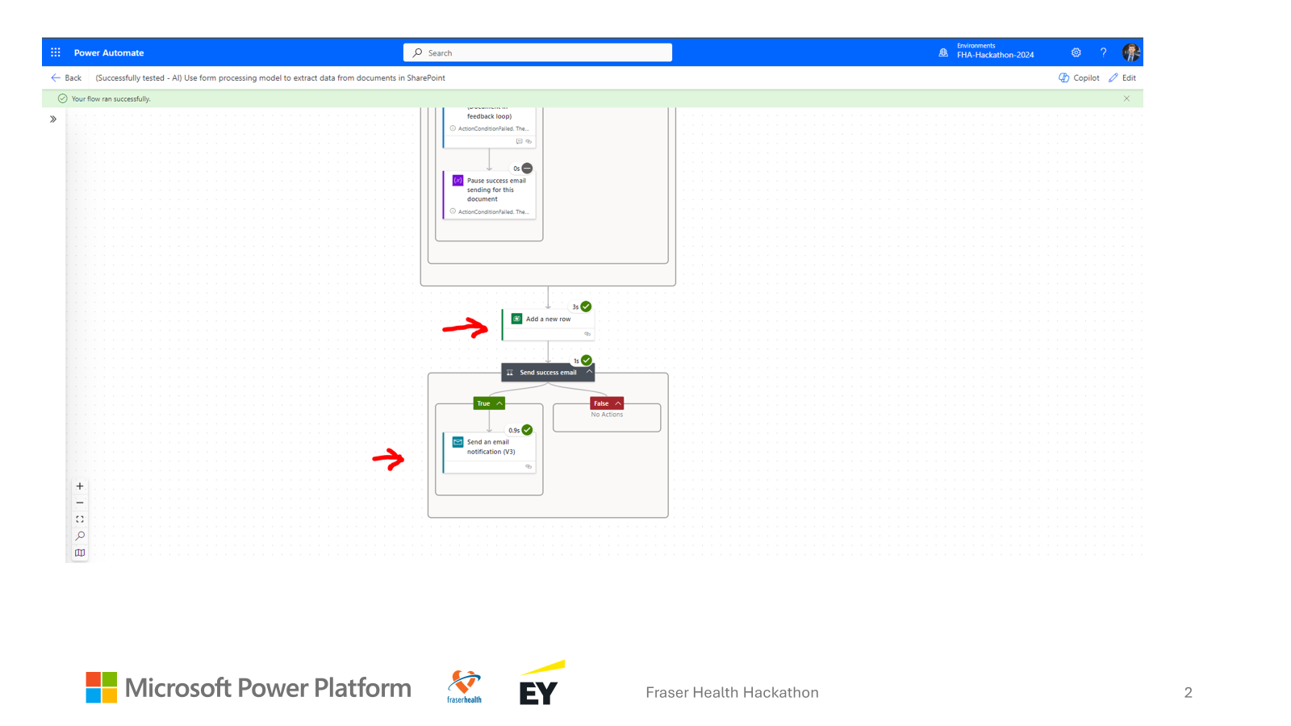
Demo

Slide 12
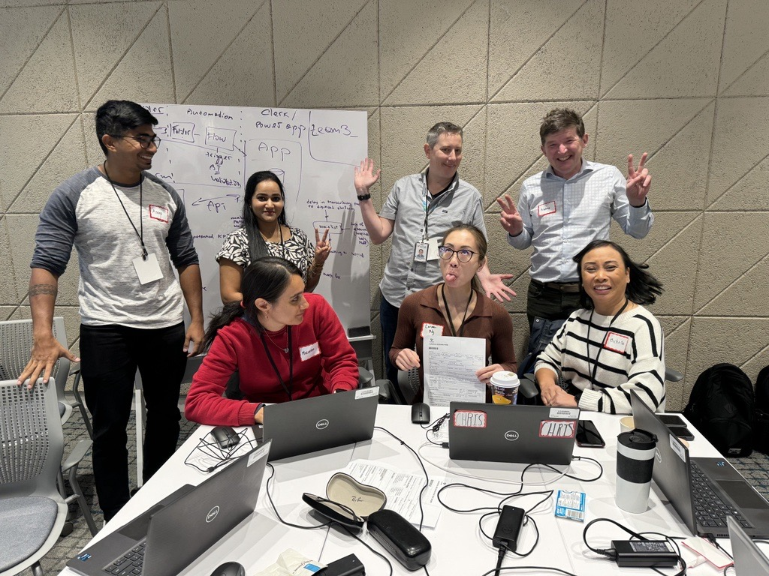
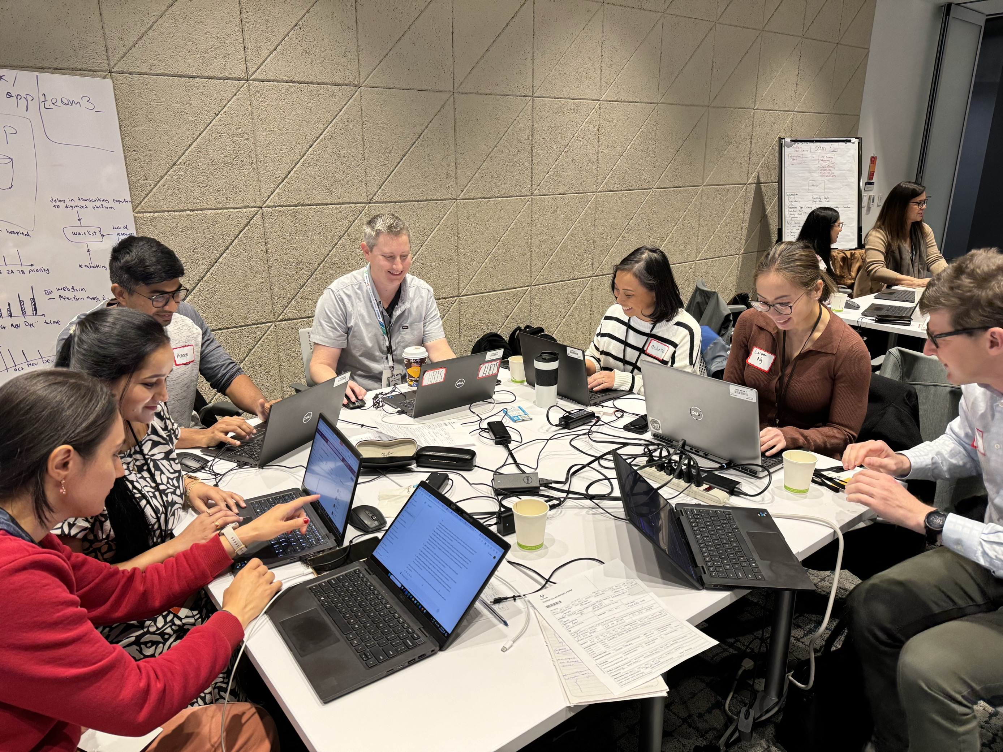
The Dream Team

Slide 13
Business Value
Feasibility: Adapted from other examples to meet our business needs
Benefits:
Increased Efficiency
Data Accuracy
Secure Data
Safety better quality data
Easy Access to data
Data Analytics
Potential ROI:
Time and cost savings
Overall Process Efficiency
Data Privacy and Security
Notes:
BENEFITS:
Feature: Eliminate Faxing and associated transcription.
Efficiency: Reduce workload clerical staff, who instead can focus on the patients they are supporting. thus, enhancing patient care.
Accuracy: Eliminate errors associated with transcription.
Safety: With errors eliminated clinical providers can make better decisions based on better quality data.
POTENTIAL ROI:
Time and cost savings: Reduces manual labor and associated costs
Efficiency: Speeds up document processing and improves workflow
Data Security: Ensures secure transmission and storage of sensitive documents

Slide 14
How will we measure success?
Number of referral forms received by option over time
Proportion of use of webform vs. e-fax over time
Number of forms rejected over time (data validation)
Time from referral to EMR entry
Provider satisfaction survey

Slide 15
Future Potentials
Next Steps:
Build integration to EMR.
Build prioritization and scheduling system within app
PowerBI dashboard to look at indicators
Comprehensive Booking Apps.
Scalability:
Can use this platform to eliminate any patient referral and booking system in the health authority that relies on faxes and referral forms (e.g. Public Health, Home Health, MHSU, LTC).

